Slide 1
Cloud Club ☁️
Docker

Slide 2

Cloud Club ☁️
Discord
https://discord.gg/V5H5Ex5Y7Y

Slide 3
Please join the student organization
Link can be found in discord

Slide 4
Schedule

Slide 5
Spring 2023 Schedule (tentative)
March 20, 2023
Discuss Docker
Hands-on-experience (Docker)
April 3, 2023
Recap on everything discussed
Project presentations
Notes:
⭐️IAC day is super awesome. Encourage everyone to attend this meeting.
Project Presentations is simply an opportunity for members to showcase any cloud-based projects they have built.

Slide 6
Docker

Slide 7
What is Docker?
One word: Containerization
It’s easiest to explain by comparison to other tools.
virtual machine
Python virtual environment

Slide 8

Why docker?
Extremely easy to deploy any application (all you need is a computer with docker)
Extremely easy to scale with tools like Kubernetes
Notes:
Visit Amazon S3

Slide 9
Docker workflow
Build docker image
Push docker image
Docker image can be pulled and run on any computer with Docker
Notes:
Visit Amazon S3

Slide 10
Dockerfile
Defines:
How the docker image should be built
What dependencies are needed
How to start the docker container (once the image is built)
Notes:
Visit Amazon S3

Slide 11
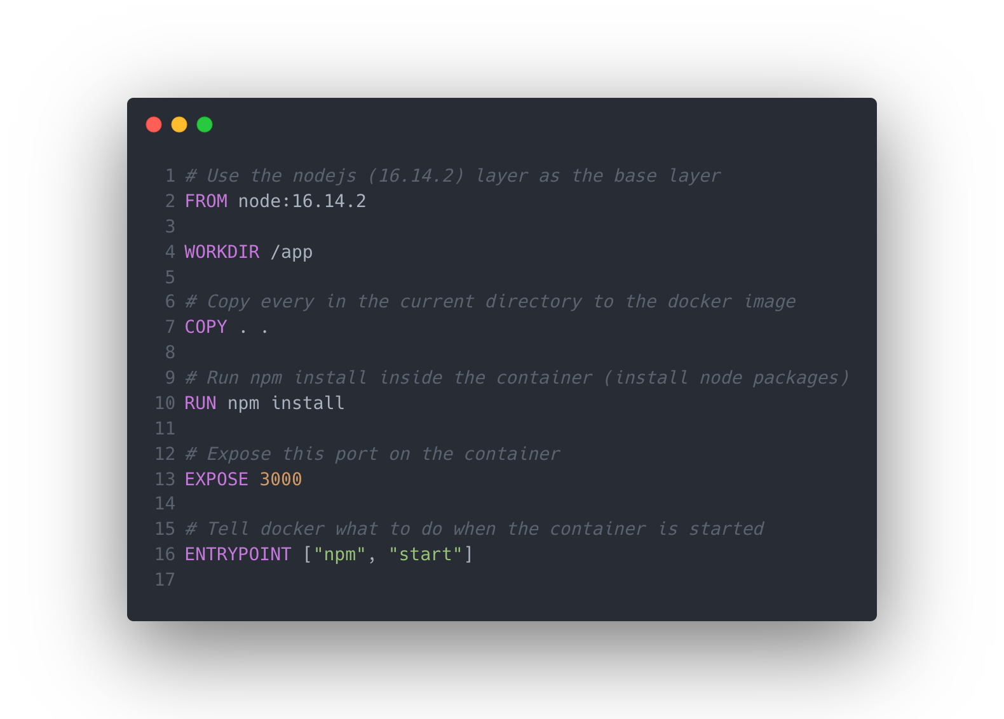
Example dockerfile - NodeJS server

Slide 12
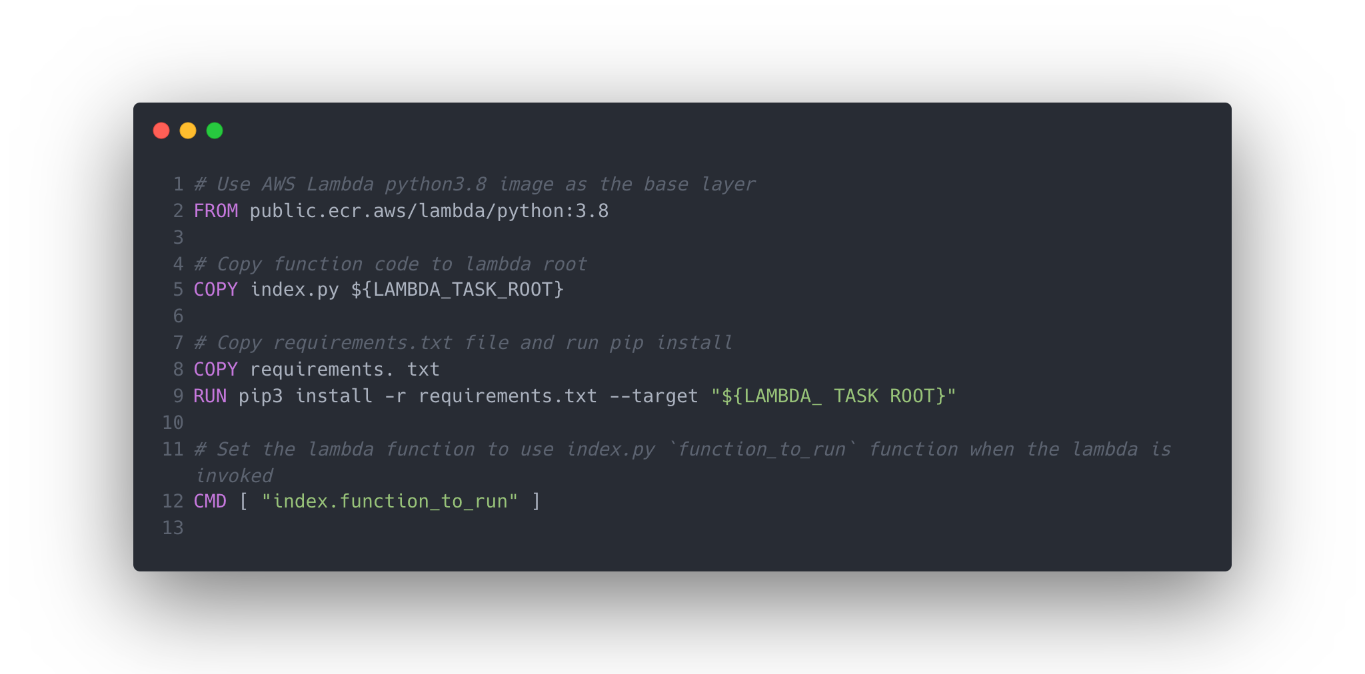
Example dockerfile - Python lambda function

Slide 13
Example Docker workflow
Assume you don’t have Java installed on your computer, but want to run a Java webserver:
Create a docker image with all dependencies*
Run the docker image
* You do not need the dependencies on your computer to create the image with said dependencies.
Notes:
Visit Amazon S3

Slide 14
Hands-on experience

Slide 15
Hands-on Experience
Install Docker on your computer:
MacOS: Docker Desktop
Windows: Rancher (this requires WSL)
Linux: Docker CLI

Slide 16
Hands-on Experience
Docker
Navigate to Dockerhub
Find a basic docker image of your liking
Examples: NodeJS webserver, Java webserver, game server, etc.
Pull the image onto your computer
Run the container

Slide 17
Advanced Hands-on Experience
Docker
Choose something to containerize
Define the docker image (create a dockerfile)
Build the docker image
Start the container

Slide 18
“Homework” for the next meeting
Join the Discord
Officially join the student organization
URL in #annoncements channel on Discord

